Slide 1


Online Shopping System
Advanced Data Structures Project
SEM-3
M.sc ss

Slide 2
Agenda
Objectives
Modules
Data Structures Used
Team
Modules Split Up
Problems Faced

Slide 3
Objectives
To maintain the Service details of the store.
To make use of the suitable Data Structure.
To serve the customer according to the Priority.
To secure the customer Credentials.
To get Feedback about the service from the customer.

Slide 4
Modules
Administrator To manage the Stocks details, Customer Details, Serve the Customer.
Customer To buy the Products, generate the Bills, Manage Profile, Give Feedback.

Slide 5
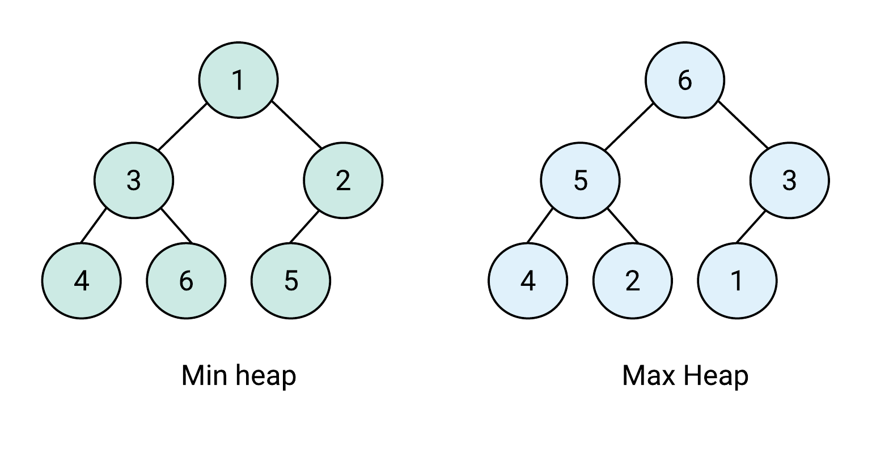
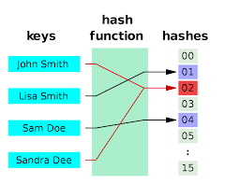
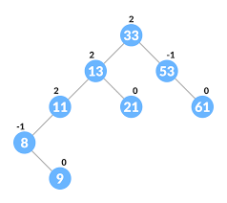
Data structures used in project
Heap
Hash
AVL Tree

Slide 6
TEAM MEMBERS
2031030 Prabhu P
2031051 Tharun Kailash K
2031053 Vignaraj D

Slide 7
Modules split up
Prabhu P
AVL Tree
Getting feedback from the customer
Tharun Kailash K
Hash
Password hashing
Vignaraj D
Heap
Heap Sort
Priority Queue

Slide 8



Problems faced
AVL Tree
Storing and retrieve the data in AVL tree
Hash
Checking the user input details and encrypted password
Hash
Serving the customer in priority wise

Slide 9
THANK YOU

